Slide 1
Tree
Attributes

Slide 2
Tree Attributes
90
50
120
40
65
100
150
30
45
70
95
LEVEL = ROW = nodes with same height
level 0 contains the root
level 1 contains the children of the root
NUMLEVELS - 4 NUMLEAVES - 5

Slide 3
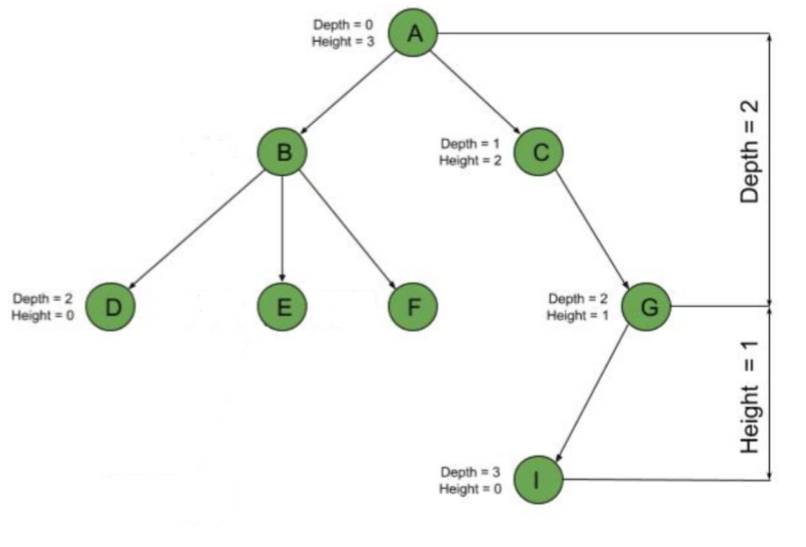
The depth of a node is the number of edges from the root to the node.
The height of a node is the number of edges from the node to the deepest leaf.

Slide 4
Height
90
50
120
40
65
100
150
30
45
70
95
HEIGHT - 3
Height = # of edges from root to lowest leaf
Notes:
The maximum distance of any node from the root. If a tree has only one node (the root), the height is zero. The height of an empty tree is not defined.

Slide 5
Diameter
90
50
120
40
65
100
150
30
45
70
95
Diameter = 7
Diameter = the number of nodes on the longest path between two nodes in the tree (does not have to go through the root!)

Slide 6
Diameter
90
50
40
65
30
45
70
Diameter = 5

Slide 7
Building a
BST

Slide 8
Building a BST
To insert a new item:
Pretend to look for the item
Put the new node in the place where you fall off the tree

Slide 9
Building a BST
Jayden

Slide 10
Building a BST
Jayden

Slide 11
Building a BST
Jayden
Fahad

Slide 12
Building a BST
Jayden
Fahad

Slide 13
Building a BST
Jayden
Fahad

Slide 14
Building a BST
Jayden
Marvin
Fahad

Slide 15
Building a BST
Jayden
Fahad
Marvin

Slide 16
Building a BST
Jayden
April
Fahad
Marvin

Slide 17
Building a BST
Jayden
April
Fahad
Marvin

Slide 18
Building a BST
Jayden
Fahad
Marvin
April

Slide 19
Building a BST
Jayden
Fahad
Marvin
April

Slide 20
Building a BST
Jayden
Fahad
march
April
June
Marvin
Carlos
Julio
Syed
Paolo
Naomi

Slide 21
Add Method
public void add(Comparable val) { root = add(val, root); } private TreeNode add(Comparable val,
TreeNode tree) {
}

Slide 22
Add Method
private TreeNode add(Comparable val,
TreeNode tree){ if(tree == null) return new TreeNode(val); Comparable treeValue = tree.getValue(); int dirTest = val.compareTo(treeValue); if(dirTest < 0) tree.setLeft(add(val, tree.getLeft())); else if(dirTest > 0) tree.setRight(add(val, tree.getRight())); return tree; }

Slide 23
BigO

Slide 24
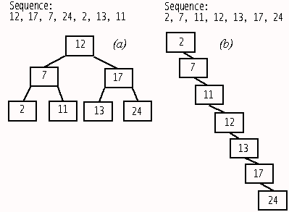
BST Big O
traverse all nodes O(N)
search for an item O(log₂N)
remove any item O(log₂N)
add item O(log₂N)
Average case
these results assume the tree is balanced or nearly balanced.
Notes:
A balanced binary tree is commonly defined as a binary tree in which the depth of the two subtrees of every node never differ by more than 1,^{[3]} although in general it is a binary tree where no leaf is much farther away from the root than any other leaf. (Different balancing schemes allow different definitions of "much farther"^{[4]}). Binary trees that are balanced according to this definition have a predictable depth (how many nodes are traversed from the root to a leaf, root counting as node 0 and subsequent as 1, 2, ..., depth). This depth is equal to the integer part of where is the number of nodes on the balanced tree. Example 1: balanced tree with 1 node, (depth = 0). Example 2: balanced tree with 3 nodes, (depth=1). Example 3: balanced tree with 5 nodes, (depth of tree is 2 nodes).

Slide 25
Worst case:
Data entered in natural order or reverse order.
Or any other tree with as many levels as nodes.
Adding O(n)
Searching O(n)
Removing O(n)

Slide 26
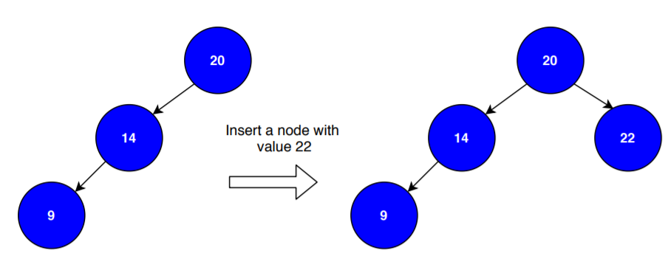
Best case = O(1)
Search value is the root
Adding to a tree with only one branch when the new value starts the other branch
Removing a node which has 0 or 1 child

Slide 27
Using a Sorted Array and the Binary Search Algorithm
traverse all nodes O(N)
search for an item O(log₂N)
remove any item O(N)
access a spot O(1)
add item O(N)
[2, 3, 5, 8, 10, 19, 23, 27, 32]
Notes:
A balanced binary tree is commonly defined as a binary tree in which the depth of the two subtrees of every node never differ by more than 1,^{[3]} although in general it is a binary tree where no leaf is much farther away from the root than any other leaf. (Different balancing schemes allow different definitions of "much farther"^{[4]}). Binary trees that are balanced according to this definition have a predictable depth (how many nodes are traversed from the root to a leaf, root counting as node 0 and subsequent as 1, 2, ..., depth). This depth is equal to the integer part of where is the number of nodes on the balanced tree. Example 1: balanced tree with 1 node, (depth = 0). Example 2: balanced tree with 3 nodes, (depth=1). Example 3: balanced tree with 5 nodes, (depth of tree is 2 nodes).

Slide 28
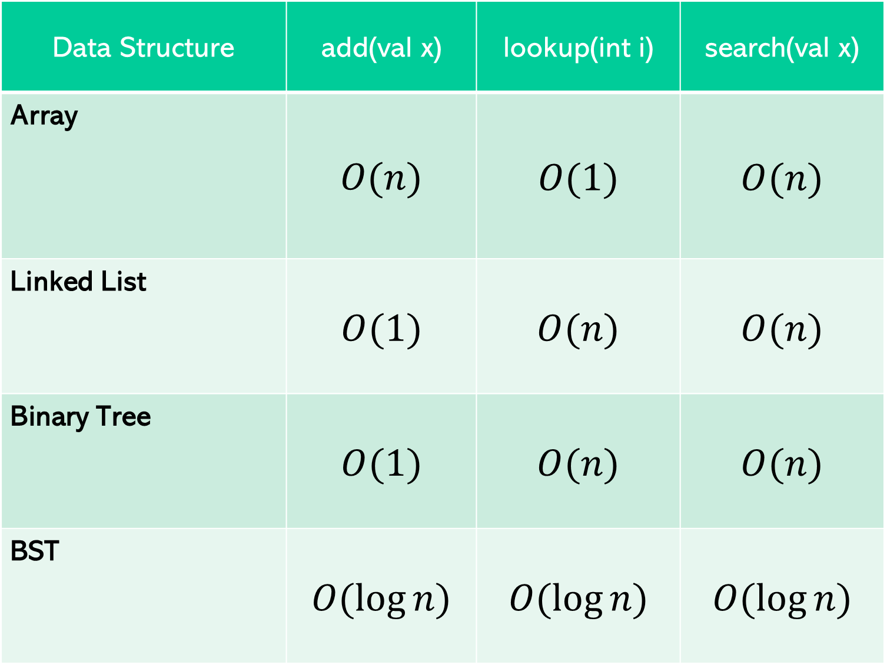
Comparing Data Structures
Data Structure | add(val x) | lookup(int i) | search(val x)
Array | $$O(n)$$ | $$O(1)$$ | $$O(n)$$
Linked List | $$O(1)$$ | $$O(n)$$ | $$O(n)$$
Binary Tree | $$O(1)$$ | $$O(n)$$ | $$O(n)$$
BST | $$O(\log{n})$$ | $$O(\log{n})$$ | $$O(\log{n})$$
2
1
3
0
2
1
3
0
1
2
3
2
1
3
Notes:
This slide is editable.

